Slide 1
REVIEW-2
MUSIC RECOMMENDATION USING FACIAL EXPRESSIONS

Slide 2
System Description The system comprises 1 major module with their sub-modules as follows: USER: Register Using basic details such as name, username, password, email, etc. Login Home Detect The emotion will be detected and the music player will start playing a particular music Logout ADMIN: Admin can log in using “username” and “password”. Admin can view all the Users.

Slide 3
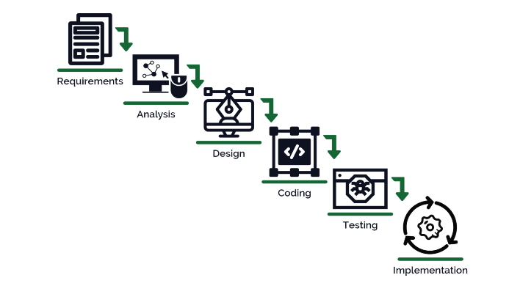
Project Life Cycle The waterfall model is a classical model used in the system development life cycle to create a system with a linear and sequential approach. It is termed a waterfall because the model develops systematically from one phase to another in a downward fashion. The waterfall approach does not define the process to go back to the previous phase to handle changes in requirements. The waterfall approach is the earliest approach that was used for software development.

Slide 4
from flask import Flask, render_template, Response, jsonify import gunicorn from camera import * app = Flask(__name__) headings = ("Name","Album","Artist") df1 = music_rec() df1 = df1.head(15) @app.route('/') def index(): print(df1.to_json(orient='records')) return render_template('index.html', headings=headings, data=df1) def gen(camera): while True: global df1 frame, df1 = camera.get_frame() yield (b'--frame\r\n' b'Content-Type: image/jpeg\r\n\r\n' + frame + b'\r\n\r\n') @app.route('/video_feed') def video_feed(): return Response(gen(VideoCamera()), mimetype='multipart/x-mixed-replace; boundary=frame') @app.route('/t') def gen_table(): return df1.to_json(orient='records') if __name__ == '__main__': app.debug = True app.run()
CODE
PYTHON;

Slide 5
import numpy as np import cv2 from PIL import Image from tensorflow.keras.models import Sequential from tensorflow.keras.layers import Dense, Dropout, Flatten from tensorflow.keras.layers import Conv2D from tensorflow.keras.optimizers import Adam from tensorflow.keras.layers import MaxPooling2D from tensorflow.keras.preprocessing.image import ImageDataGenerator from pandastable import Table, TableModel from tensorflow.keras.preprocessing import image import datetime from threading import Thread # from Spotipy import * import time import pandas as pd face_cascade=cv2.CascadeClassifier("haarcascade_frontalface_default.xml") ds_factor=0.6 emotion_model = Sequential() emotion_model.add(Conv2D(32, kernel_size=(3, 3), activation='relu', input_shape=(48,48,1))) emotion_model.add(Conv2D(64, kernel_size=(3, 3), activation='relu')) emotion_model.add(MaxPooling2D(pool_size=(2, 2))) emotion_model.add(Dropout(0.25)) emotion_model.add(Conv2D(128, kernel_size=(3, 3), activation='relu')) emotion_model.add(MaxPooling2D(pool_size=(2, 2))) emotion_model.add(Conv2D(128, kernel_size=(3, 3), activation='relu')) emotion_model.add(MaxPooling2D(pool_size=(2, 2))) emotion_model.add(Dropout(0.25)) emotion_model.add(Flatten()) emotion_model.add(Dense(1024, activation='relu')) emotion_model.add(Dropout(0.5)) emotion_model.add(Dense(7, activation='softmax')) emotion_model.load_weights('model.h5') cv2.ocl.setUseOpenCL(False) emotion_dict = {0:"Angry",1:"Disgusted",2:"Fearful",3:"Happy",4:"Neutral",5:"Sad",6:"Surprised"} music_dist={0:"songs/angry.csv",1:"songs/disgusted.csv ",2:"songs/fearful.csv",3:"songs/happy.csv",4:"songs/neutral.csv",5:"songs/sad.csv",6:"songs/surprised.csv"} global last_frame1 last_frame1 = np.zeros((480, 640, 3), dtype=np.uint8) global cap1 show_text=[0]
VIDEO READING

Slide 6
''' Class for calculating FPS while streaming. Used this to check performance of using another thread for video streaming ''' class FPS: def __init__(self): # store the start time, end time, and total number of frames # that were examined between the start and end intervals self._start = None self._end = None self._numFrames = 0 def start(self): # start the timer self._start = datetime.datetime.now() return self def stop(self): # stop the timer self._end = datetime.datetime.now() def update(self): # increment the total number of frames examined during the # start and end intervals self._numFrames += 1 def elapsed(self): # return the total number of seconds between the start and # end interval return (self._end - self._start).total_seconds() def fps(self): # compute the (approximate) frames per second return self._numFrames / self.elapsed()

Slide 7
''' Class for using another thread for video streaming to boost performance ''' class WebcamVideoStream: def __init__(self, src=0): self.stream = cv2.VideoCapture(src,cv2.CAP_DSHOW) (self.grabbed, self.frame) = self.stream.read() self.stopped = False def start(self): # start the thread to read frames from the video stream Thread(target=self.update, args=()).start() return self def update(self): # keep looping infinitely until the thread is stopped while True: # if the thread indicator variable is set, stop the thread if self.stopped: return # otherwise, read the next frame from the stream (self.grabbed, self.frame) = self.stream.read() def read(self): # return the frame most recently read return self.frame def stop(self): # indicate that the thread should be stopped self.stopped = True

Slide 8
''' Class for reading video stream, generating prediction and recommendations ''' class VideoCamera(object): def get_frame(self): global cap1 global df1 cap1 = WebcamVideoStream(src=0).start() image = cap1.read() image=cv2.resize(image,(600,500)) gray=cv2.cvtColor(image,cv2.COLOR_BGR2GRAY) face_rects=face_cascade.detectMultiScale(gray,1.3,5) df1 = pd.read_csv(music_dist[show_text[0]]) df1 = df1[['Name','Album','Artist']] df1 = df1.head(15) for (x,y,w,h) in face_rects: cv2.rectangle(image,(x,y-50),(x+w,y+h+10),(0,255,0),2) roi_gray_frame = gray[y:y + h, x:x + w] cropped_img = np.expand_dims(np.expand_dims(cv2.resize(roi_gray_frame, (48, 48)), -1), 0) prediction = emotion_model.predict(cropped_img) maxindex = int(np.argmax(prediction)) show_text[0] = maxindex #print("===========================================",music_dist[show_text[0]],"===========================================") #print(df1) cv2.putText(image, emotion_dict[maxindex], (x+20, y-60), cv2.FONT_HERSHEY_SIMPLEX, 1, (255, 255, 255), 2, cv2.LINE_AA) df1 = music_rec() global last_frame1 last_frame1 = image.copy() pic = cv2.cvtColor(last_frame1, cv2.COLOR_BGR2RGB) img = Image.fromarray(last_frame1) img = np.array(img) ret, jpeg = cv2.imencode('.jpg', img) return jpeg.tobytes(), df1 def music_rec(): # print('---------------- Value ------------', music_dist[show_text[0]]) df = pd.read_csv(music_dist[show_text[0]]) df = df[['Name','Album','Artist']] df = df.head(15) return df

Slide 9
.outer-shadow { --outer-shadow: 3px 3px 3px #d0d0d0, -3px -3px 3px #f8f8f8; box-shadow: var(--outer-shadow); } .inner-shadow { --inner-shadow: inset 3px 3px 3px #d0d0d0, inset -3px -3px 3px #f8f8f8; box-shadow: var(--inner-shadow); }
CSS

